Slide 1
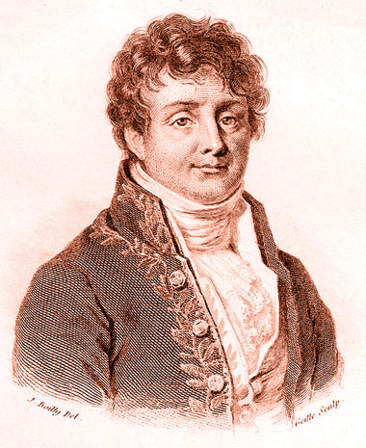
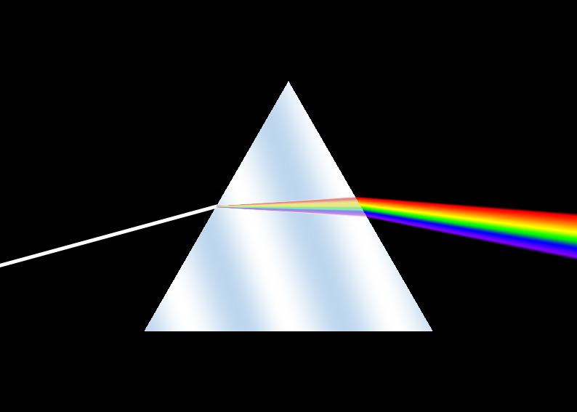
Function Approximation: Fourier Series
Jean Baptiste Joseph Fourier, 1768-1830

Slide 2
Fourier Series
Representing a function as a trigonometric series
f(x) need be integrable so that the coefficients can be computed

Slide 3
How to compute A_{n} and B_{n}?
We’ll first assume f(x) is a periodic function with period 2π
Exploit the orthogonal property of sine and cosine functions within [-π, π]!
Later, we’ll generalize the derivation for periodic functions with periods other than 2π

Slide 4
Orthogonal Properties
Notes:
Sine is an odd function; cosine is an even function.
sin(nx)sin(mx) = [cos(n-m)x – cos(n+m)x]/2
cos(nx)cos(mx) = [cos(n-m)x + cos(n+m)x]/2

Slide 5
Computing Fourier Coefficients using Orthogonality

Slide 6
Computing Fourier Coefficients using Orthogonality (cont.)

Slide 7
Fourier Series for Periods other than 2π
Let the period of f(x) be P
Consider that f(x) is periodic in [-P/2, P/2]
Change of variable

Slide 8
Fourier Series for Periods other than 2π

Slide 9
Example: f(x) = x, x in [-π,π]

Slide 10
Fourier Series for Nonperiodic Functions
Chop the interval of interest [0, L]
Make a periodic function with period L
Even extension
Odd extension
L

Slide 11
Fourier Series for Nonperiodic Functions: Even Extension
Solution 1: make an even function by reflecting the segment about y-axis, f(x)=f(-x)
L

Slide 12
Fourier Series for Nonperiodic Functions: Odd Extension
Solution 2: make an odd function by reflecting the segment about the origin, f(-x) = -f(x)
L

Slide 13
Properties of Even and Odd Functions
Product of two even functions is an even function
Product of two odd functions is an even function
Product of an even function and an odd function is an odd function

Slide 14
Fourier Series for Even Functions
even function
odd function

Slide 15
Fourier Series for Odd Functions
odd function
even function

Slide 16
Example: Fourier Series of Nonperiodic Functions—even extension
y
1
x
-2
-1
1
2

Slide 17
Example: Fourier Series of Nonperiodic Functions—odd extension
y
1
x
-2
-1
1
2
-1

Slide 18
Summary
For periodic functions
For non-periodic functions
Chop the interval of interest
Extend it to an even or odd periodic function
Orthogonal functions

